Slide 1
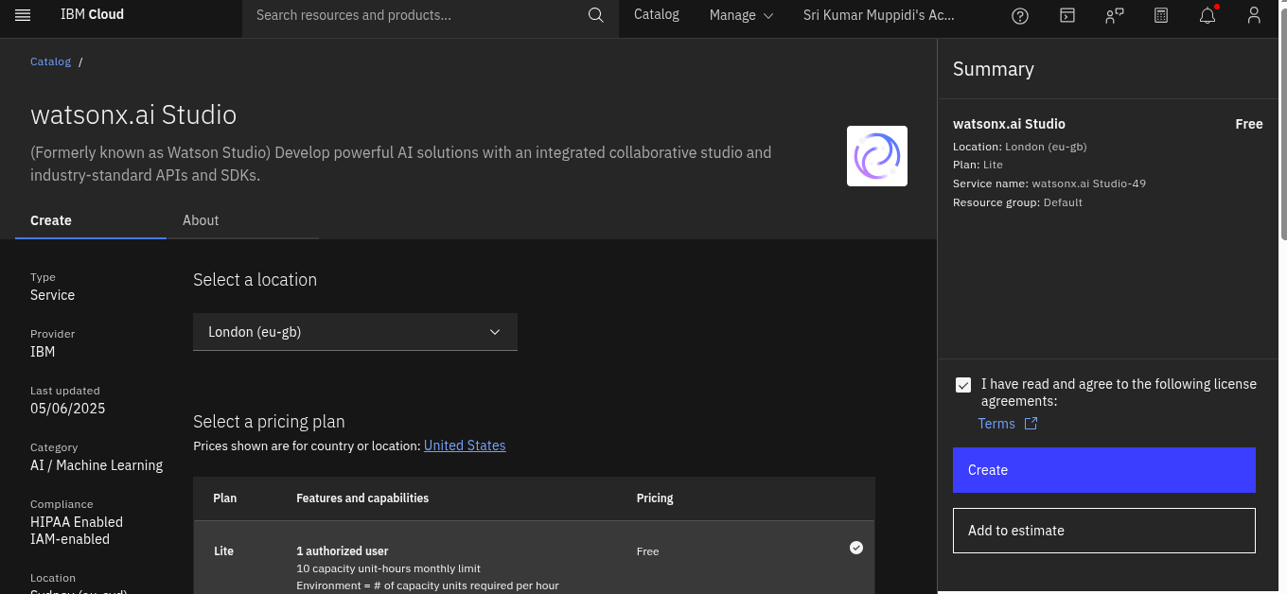
STEPS TO CREATE PREDICTIVE MAINTAINANCE PROJECT USING ML
First step:- Search watsonx.ai studio
Set location london and create studio

Slide 2
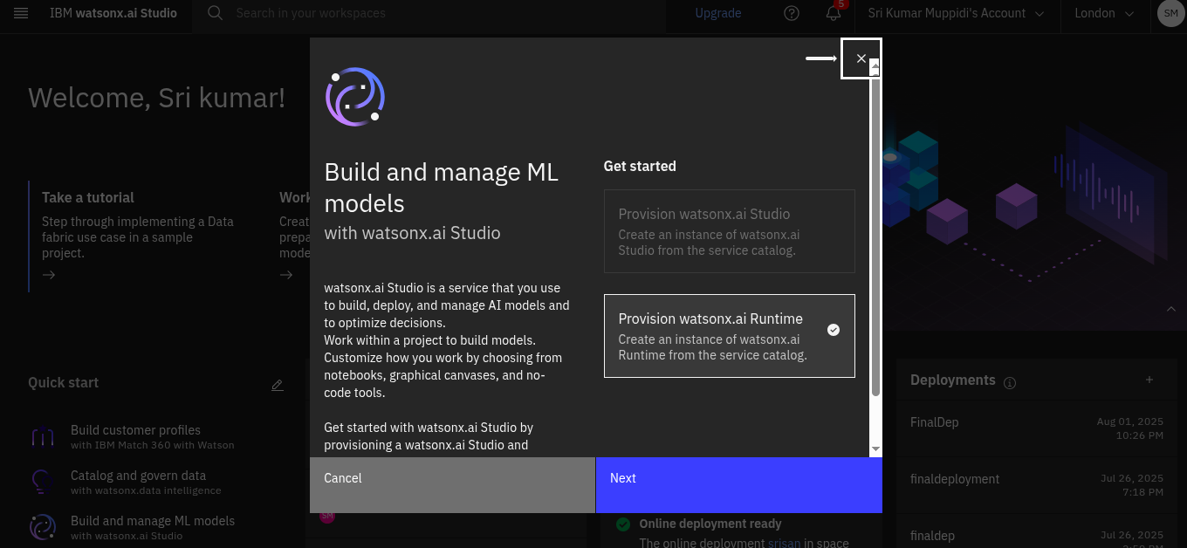
Step 2 :-
Click on next here

Slide 3
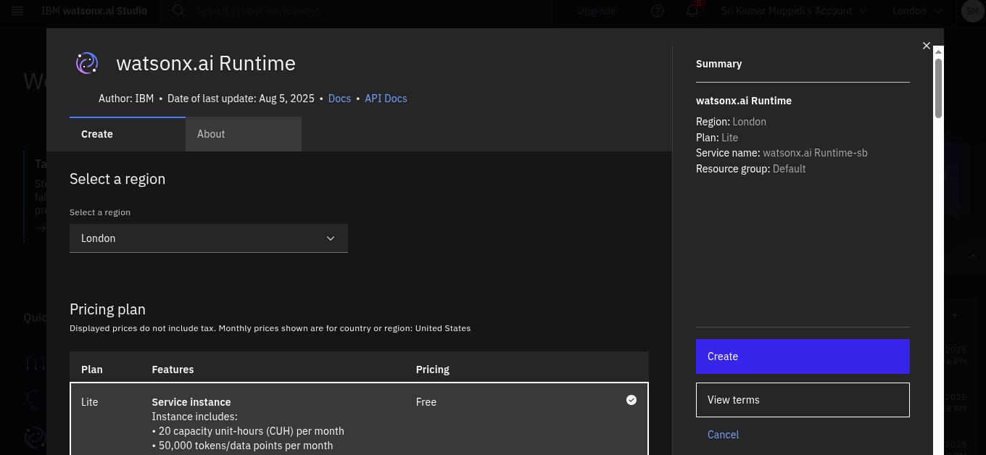
Step 3:-
Create watsonx.ai runtime

Slide 4
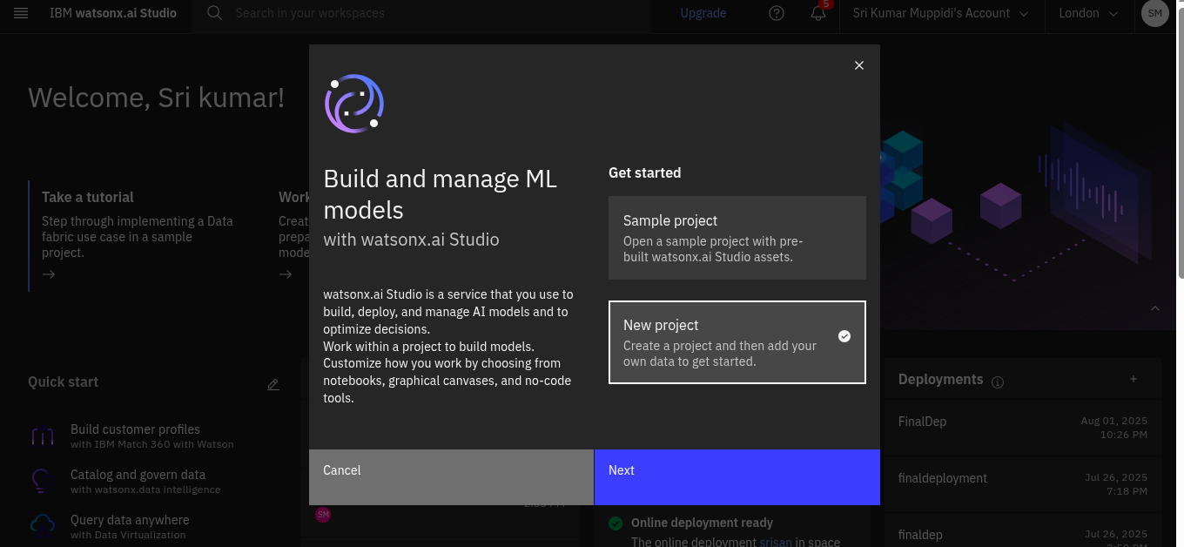
Step 4:-
Create a new project and click on next

Slide 5
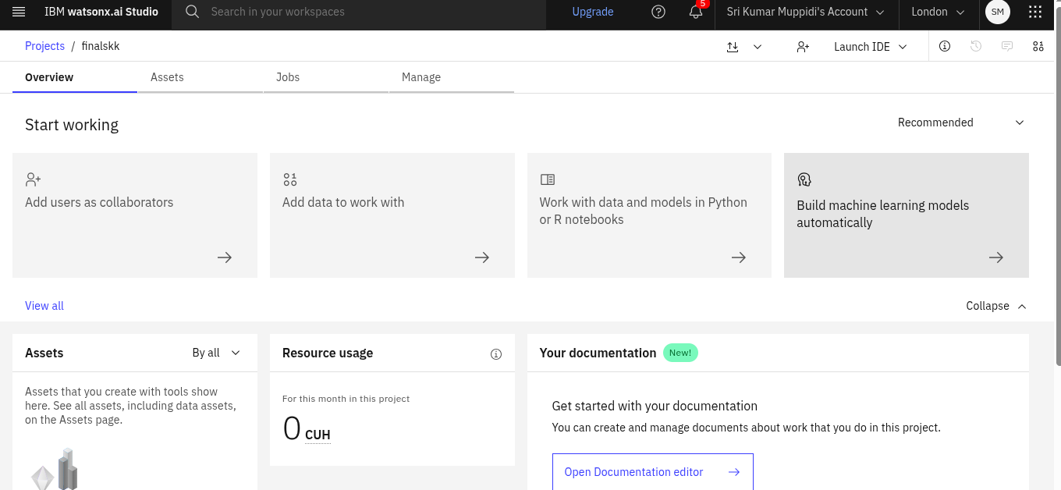
Step 5:-
Click on manage and go to service & integrations and Associate service as watsonx.ai runtime

Slide 6
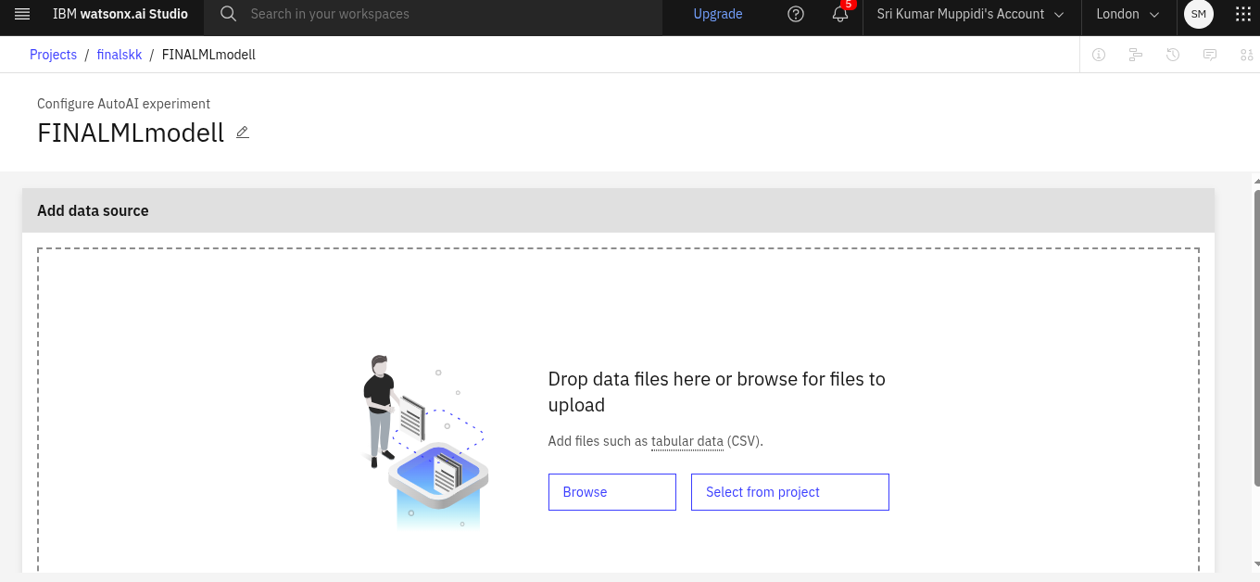
Step 6:-
Select browse and click on file to be selected

Slide 7
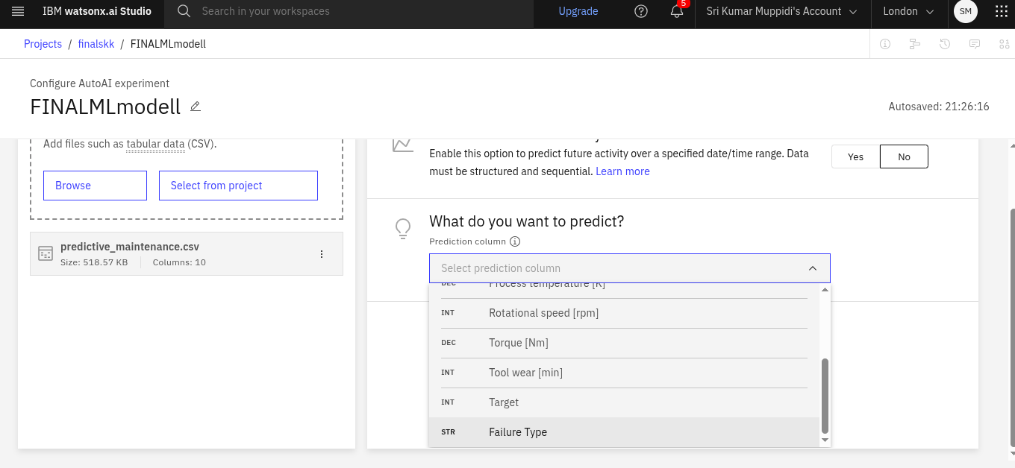
Step 7:-
Select failure type and proceed

Slide 8
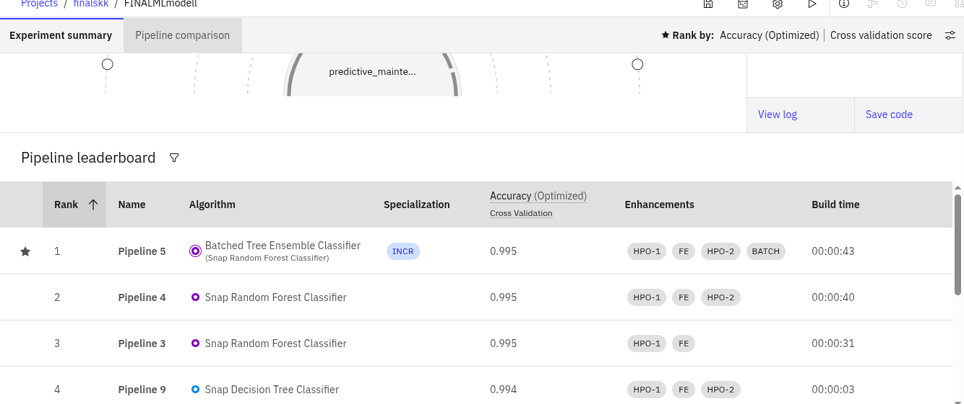
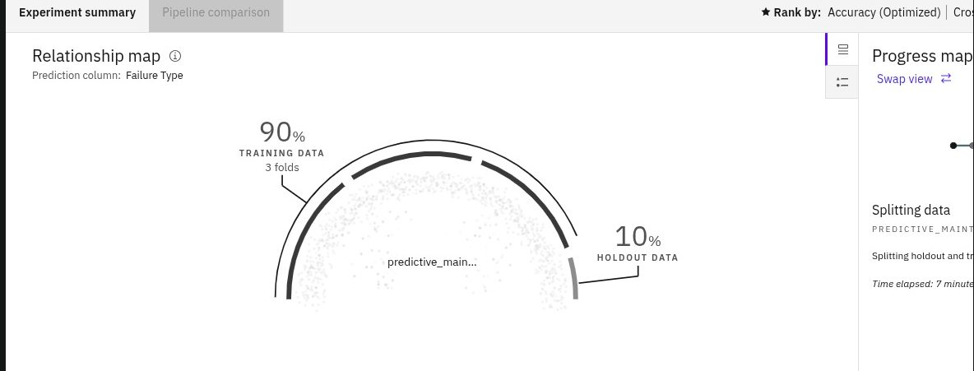
Step 8:-
Save the random forest classifier and deploy the project with a name

Slide 9
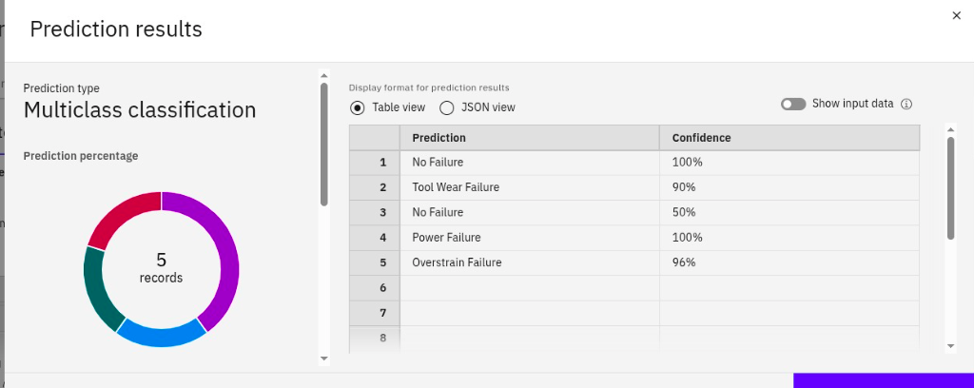
Step 9:-
Final prediction result of project

